Slide 1
Understanding the meaning and implications of Expand My Results
Yoel Kortick
Senior Librarian

Slide 2

Agenda
The question
The active portfolio for the journal
The two sample articles in the journal
The "Expand My Results"
Removing the "Expand My Results"

Slide 3
The question

Slide 4
The question
We have a subscription to the journal “Library Journal” (ISSN: 0363-0277). The portfolio in Alma in active. I see some of the articles from this journal when I search CDI in Discovery. But other articles I do not see. How come?

Slide 5
The question
For example, I do see this when searching CDI:
  A Writer's Life with Librarians
  Thomas, Matthew
  Library Journal, 2014-08, Vol.139 (13), p.90
But I do not see this when searching CDI:
  What Librarians Are Thinking About
  Lewis, Willard P.
  Library Journal, 1944-03, Vol.68 (5), p.191-191

Slide 6
The active portfolio for the journal

Slide 7
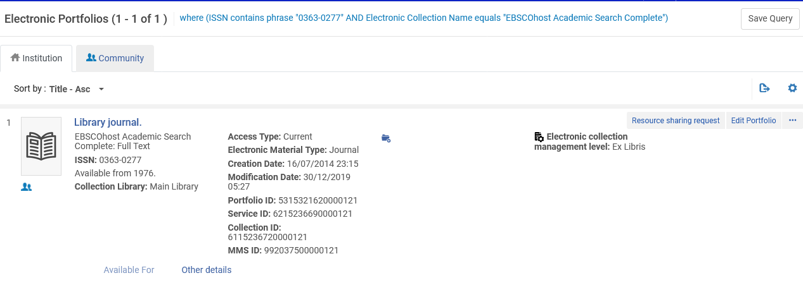
The active portfolio for the journal
Here is the active portfolio of the journal
where (ISSN contains phrase "0363-0277" AND Electronic Collection Name equals "EBSCOhost Academic Search Complete")
As we can see here, the resource is available from 1976

Slide 8
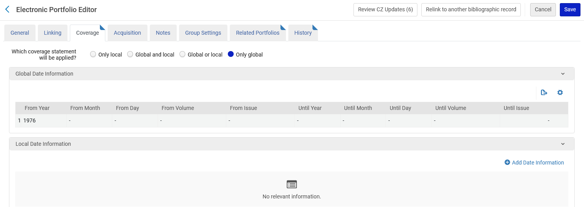
The active portfolio for the journal
Here is the “coverage” tab of the active portfolio of the journal
Here we see that the resource is available from 1976

Slide 9
The two sample articles in the journal

Slide 10
The two sample articles in the journal
This article is found in CDI.
The reason it is found is because it is within the coverage of the journal.
The journal coverage is available from 1976
The article is from 2014.
  A Writer's Life with Librarians
  Thomas, Matthew
  Library Journal, 2014-08, Vol.139 (13), p.90

Slide 11
The two sample articles in the journal
This article is not found in CDI.
The reason it is not found is because it is not within the coverage of the journal.
The journal coverage is available from 1976.
The article is from 1944.
  What Librarians Are Thinking About
  Lewis, Willard P.
  Library Journal, 1944-03, Vol.68 (5), p.191-191

Slide 12
The two sample articles in the journal
Only articles within the coverage of the journal will be found when searching CDI (unless, as we will soon see, “Expand My Results” is checked)

Slide 13
The "Expand My Results"

Slide 14
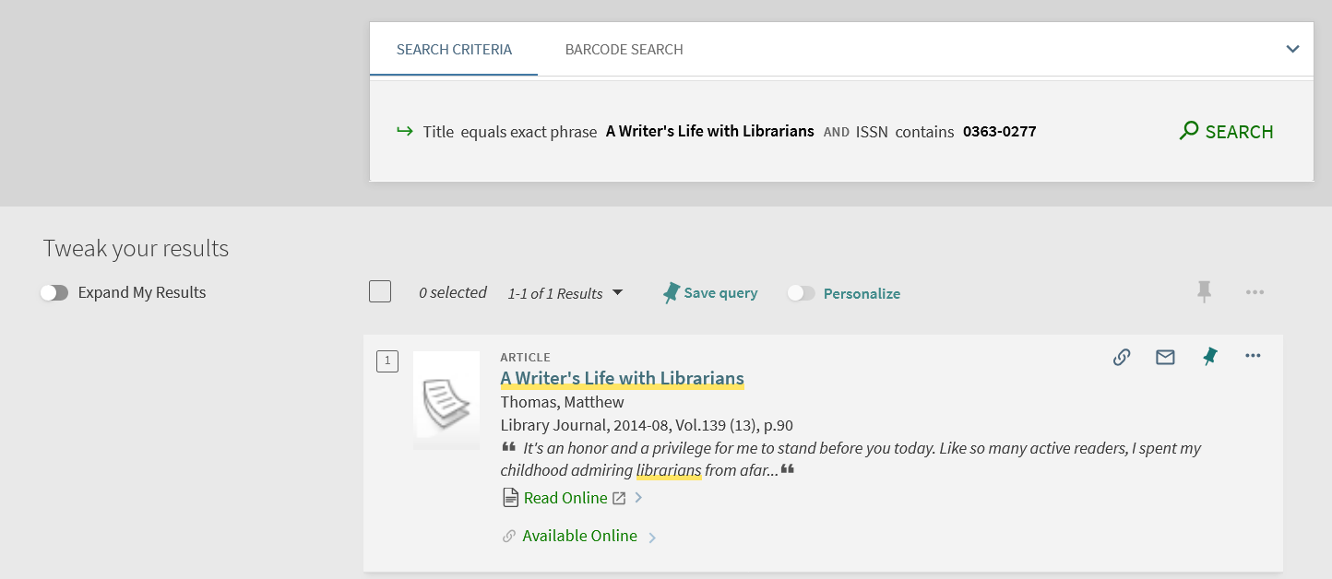
The "Expand My Results"
Here we do find the article which is within the coverage of the resource.
Note that “Expand My Results” is not checked

Slide 15
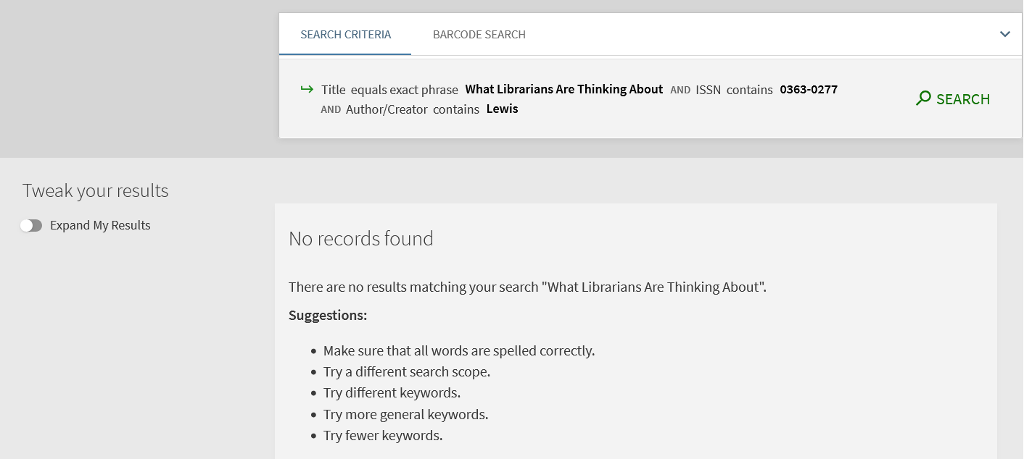
The "Expand My Results"
Here we do not find the article which is not within the coverage of the resource.
Note that “Expand My Results” is not checked

Slide 16
The "Expand My Results"
If, however, we search for the article which is not within coverage of the resource in Alma, and we do check “Expand My Results”, then we will find the article.
The “Expand My Results” allows the end user to see all results answering the search query, regardless of whether the institution has access to the resources in the results.

Slide 17
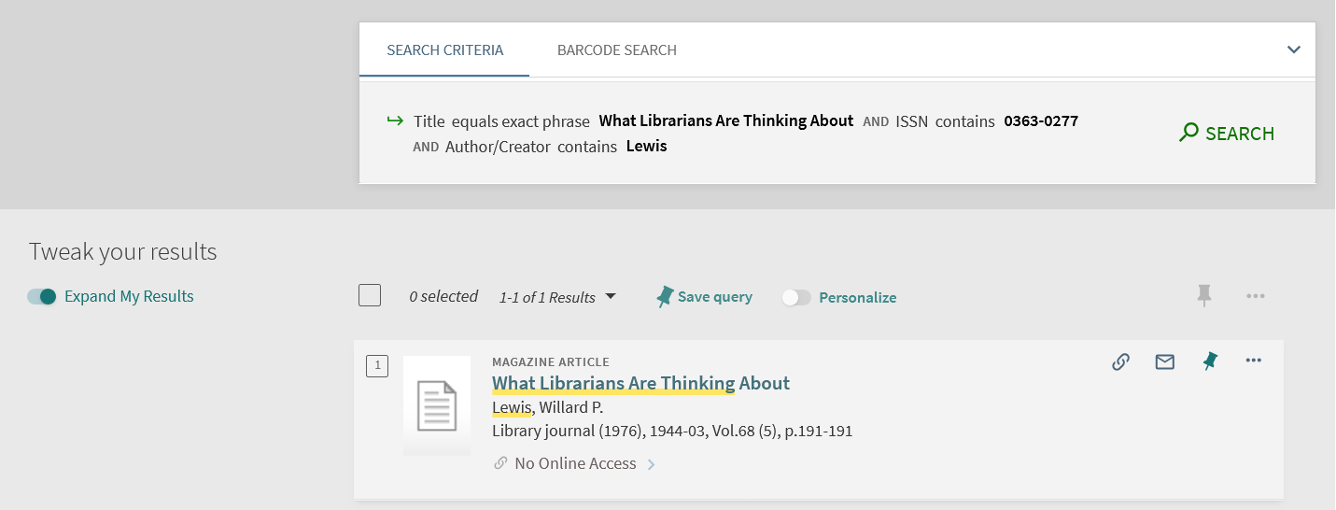
The "Expand My Results"
Now we do find the article, but with “No Online Access”
Note that “Expand My Results” is checked
There is no access to the article because it is not within the coverage of the resource

Slide 18
Removing the "Expand My Results"

Slide 19
Removing the "Expand My Results"
To remove the “Expand My Results”:
Navigate to “Configuration > Discovery > Search Configuration > Search Profiles”
Edit any search profiles that include "Central Index"
Uncheck the "Filter by Availability" option
Save.
The “Expand My Results” option will disappear, and the discovery will behave as if it were there and checked.

Slide 20
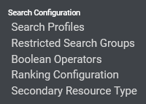
Removing the "Expand My Results"
Navigate to “Configuration > Discovery > Search Configuration > Search Profiles”

Slide 21
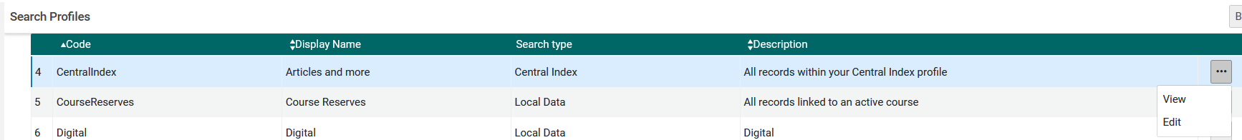
Removing the "Expand My Results"
Edit any search profiles that include "Central Index".

Slide 22
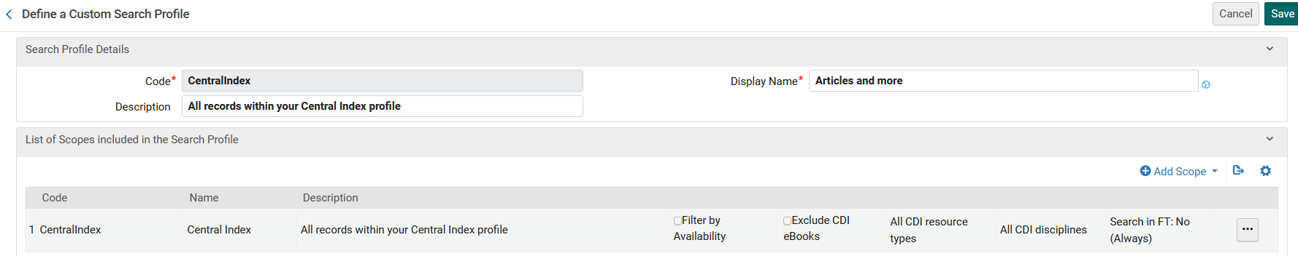
Removing the "Expand My Results"
Uncheck the "Filter by Availability" option

Slide 23
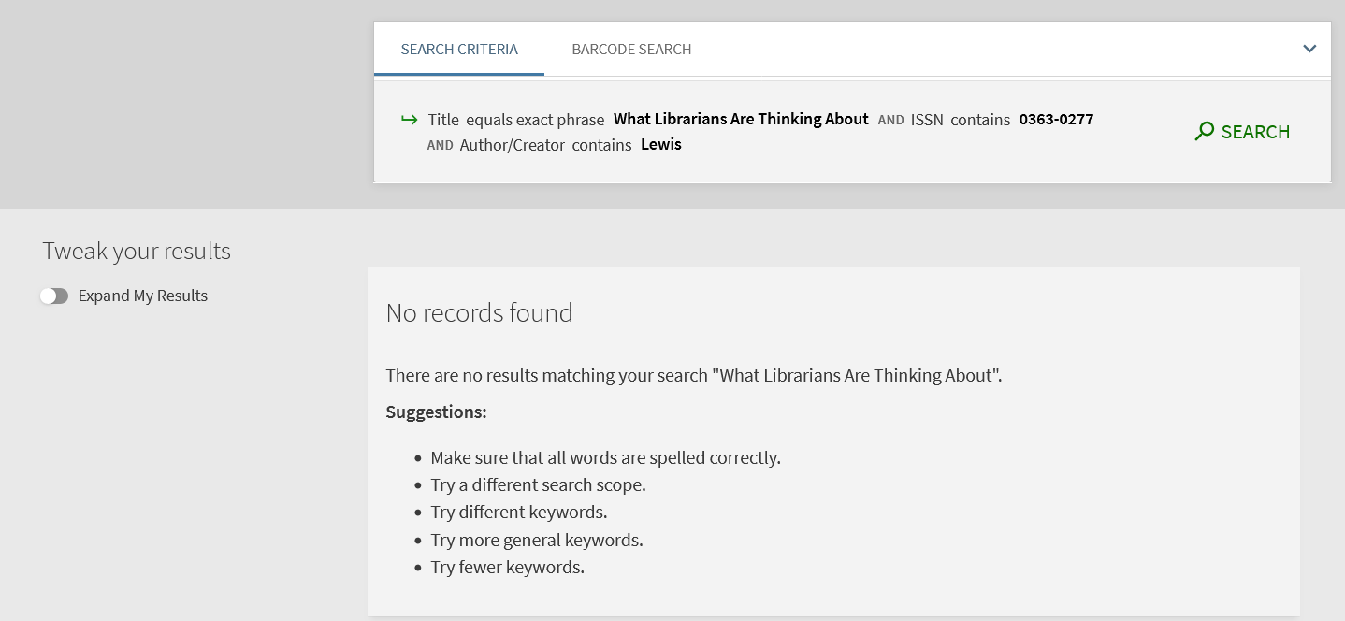
Removing the "Expand My Results"
Appearance before unchecking the "Filter by Availability" option

Slide 24
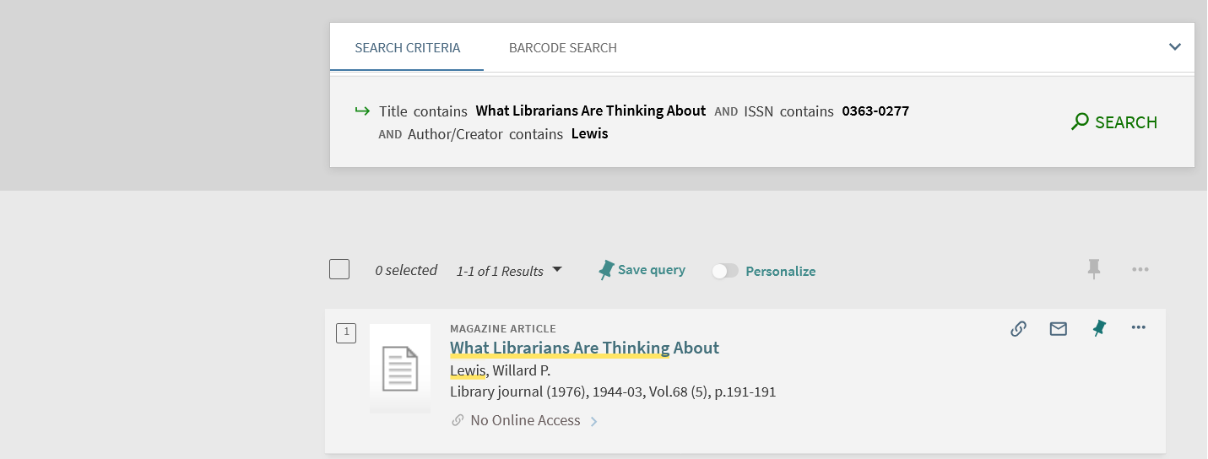
Removing the "Expand My Results"
Appearance after unchecking the "Filter by Availability" option
No option to check “Expand My Results”
It behaves as if “Expand My Results” is checked

Slide 25
xxx@exlibrisgroup.com

